Slide 1
Lending Club Loan Analysis
Presented by: Vaibhav Dixit and Rohini Mandge
Academic advisor: Prof. Yijun Zhao
CISC5950:Big-data Programming
Fordham University Spring 2018

Slide 2
Overview
About Lending club & Business Problem
Data Description
Explanatory Data Analysis
Data Preparation & Processing
Models (Using MLlib)
Logistic Regression
Naïve Bayes
Random Forest
Gradient Boosting Classifier
SVM*
Summary of results
Usefulness of model
Future work
Notes:
This is the general overview of what we are planning to present today.
First we will give an overview of Lending club and what is the business problem we are trying to solve.
Then we will discuss about the data explanatory analysis that we performed on the data set.
Following this we will briefly discuss the about the data set, how we prepare and set up the data for our machine learning model.
After that we will take a closer look at the machine learning process and how we use the spark MLlib to implement the machine learning algorithms.
And then summary and conclusion

Slide 3
Overview of Lending club and the Business Problem
Lending Club
Borrower
Investors
Lending Club is a Peer-to-Peer lending company that utilizes group of private investors to fund loan requests.
Lending Club assigns each borrower a grade and subgrades
based on their credit history.
Investors are presented with a list of loan requests along with their grades
and borrower details
Then they select loan request they will fund/partially fund.
Lending Club makes money by charging borrowers an origination fee
and a service fee to investors.
Our business problem is to build a model which will give a more comprehensive assessment of borrowers than what is presented by Lending Club in order to reduce investment risk.
Notes:
Lending Club is an online peer to peer credit marketplace which matches borrowers and investors.
Lending club assigns each borrower a grade and a sub-grade based on their credit history.
These grades are assigned within alphabetical range from A to G. Each of these letter grades has five finer-grain sub-grades, numbered 1 to 5, with 1 being the highest category with-in the grade
They evaluate their credit-worthiness based on these grades
This rating information is made available to all the investors who fund the load requests.
The grading help the investors to make a decision of which loan request they will fund. Or how much of that loan request they want to fund.
In addition to these grading lending club provides historical performance data to the investors so that they can perform more comprehensive analysis.
Our goal is to perform explanatory data analysis using apache spark framework to develop business insights from the historical loan data.
As per the recent studies 3-4% loans default every year. This is a huge risk for investors. So our goal is to develop a model which identifies which borrowers are more likely to default on their loans. This model can be used by investors to limit their investment risk.
Lending Club makes money by charging borrowers an origination fee and investors a service fee.

Slide 4
Data Description
Lending Club has provided historical data since its origination (2007-2015) under open source license.
This dataset contained information pertaining to the borrower’s past credit history, employment, income details and Lending Club loan information. The total dataset consisted of 80+ features and over 850,000 records.
The variables which are used in this data provide ample amount of information which we could use to predict loan default likelihood.
We only required variables which have direct response to borrower’s potential to default. We
used feature selection techniques and business knowledge for choosing relevant variables.
This data is structured data with lot of missing/null values. Includes continuous, ordinal
and nominal feature types.
Notes:
Lending club provides us a good quality of historical data.
We accessed over 800,000 records compiled over the period of year 2007-2015.
The variables which are include in this data set provides ample amount of information from which we could identify that if the borrowers are likely to default on their loans.
We require only selected variables which have direct response to borrower’s potential to default. So we prepared our own data set by choosing these variables.
For explanatory analysis which we performed using apache spark we used the whole data set.

Slide 5
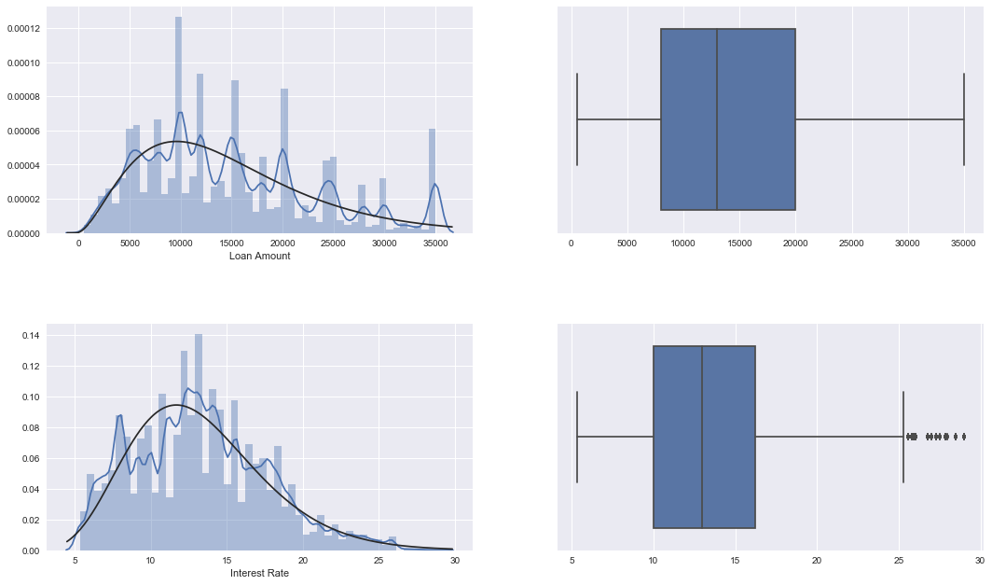
Data Explanatory Analysis
Analyzing Loan amount and Interest rates
Distribution Plot of loan amount
Distribution Plot of Interest Rate
Notes:
Show on the slide here are the distribution plots of loan amount and interest rate.
We have developed plots for every features to find out the their distributions
We need this distribution to develop the probability distribution function to find out the maximum likelihood of each feature.
Some of the variables have exponential distribution so we developed the pdf for those as well.

Slide 6
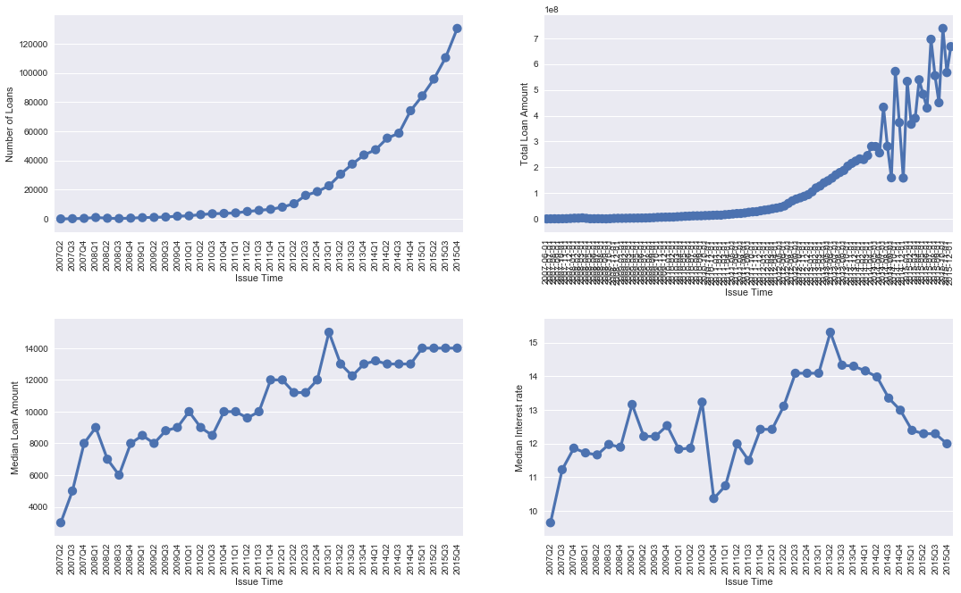
Data Explanatory Analysis
Analyzing Loans Interest rates over time
Number of loans over the time
Median interest rate over the time
Notes:
Here we can see that the popularity of LC has increased over the period of time.
The median interest rate was increased during 2012-2013. May be because of some financial crisis during that period!!!
Created bins
Used buketizer – computational expensiv
Wrote cutom logic

Slide 7
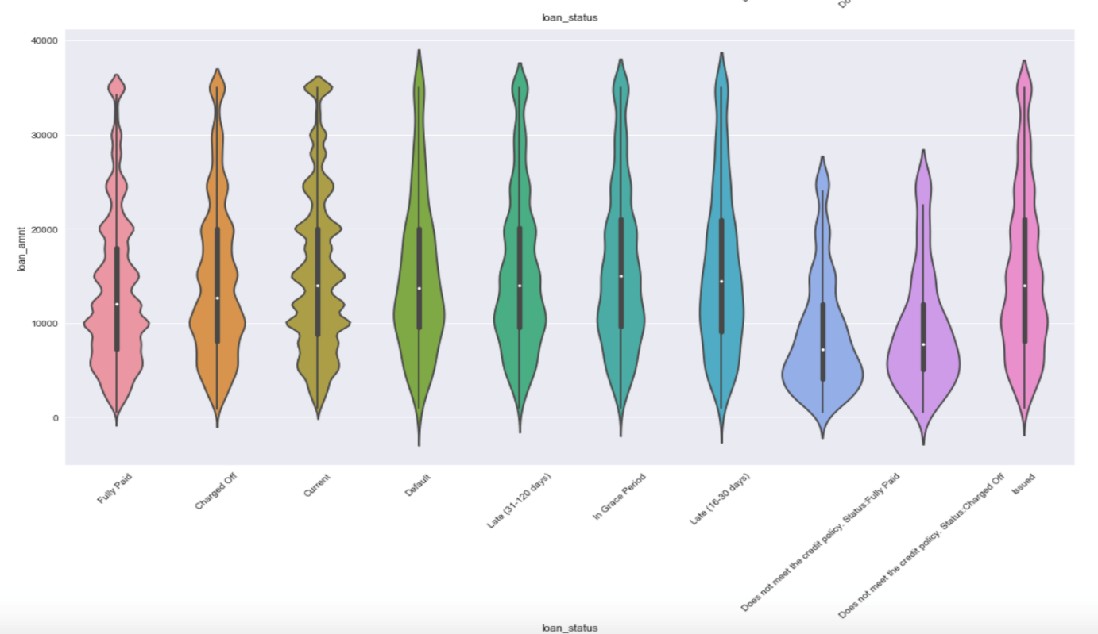
Data Explanatory Analysis
Analyzing Loan amounts over loan status
Figure: Violin plot for loan status
Notes:
A Violin Plots are used to visualize the distribution of the data and its probability density.
From this violin plot we can see that the loan amount for all the loan status is almost normally distributed.

Slide 8
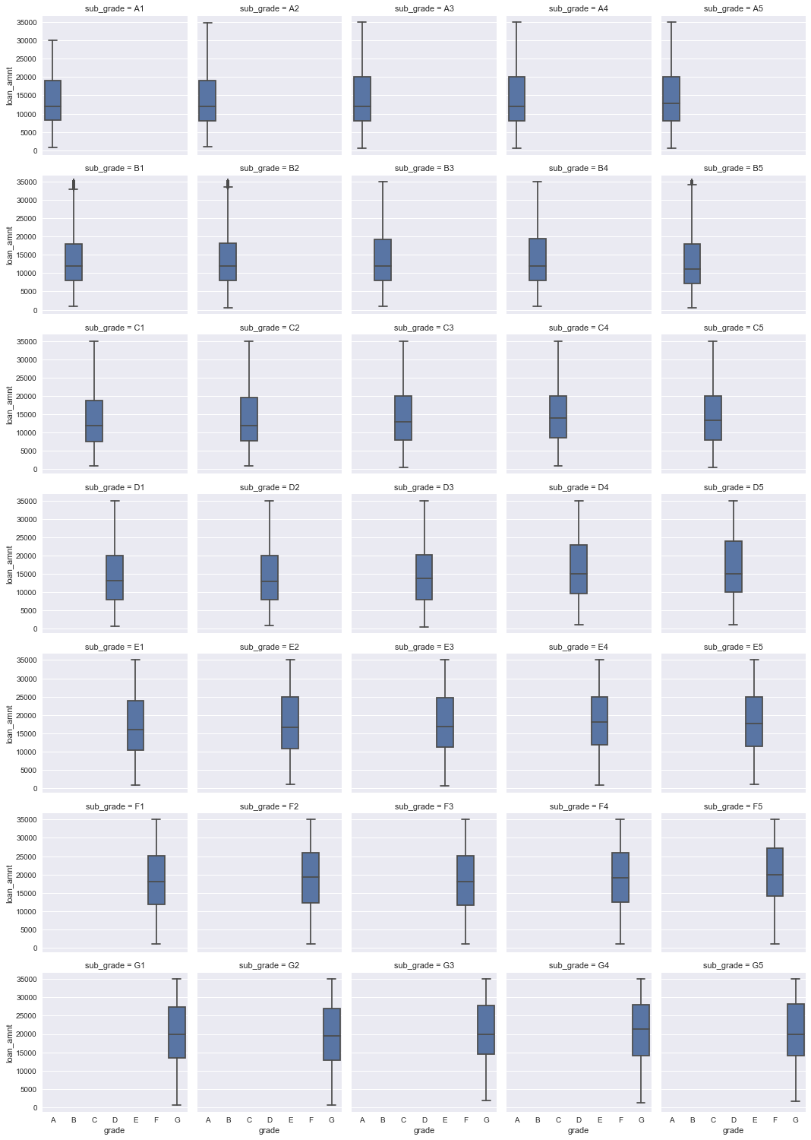
Data Explanatory Analysis
Analyzing loan amount distribution for each grade, factored over sub grade.
Figure 1: Analysis of loan amount for Grade A
Figure 2: Analysis of loan amount for Grade G
Notes:
From this box plot we can see that the requirement of loan amount is less if the grading is high.
We can see that the lower grade G has more requirement than the higher grade A
Higher grade – financial strong

Slide 9
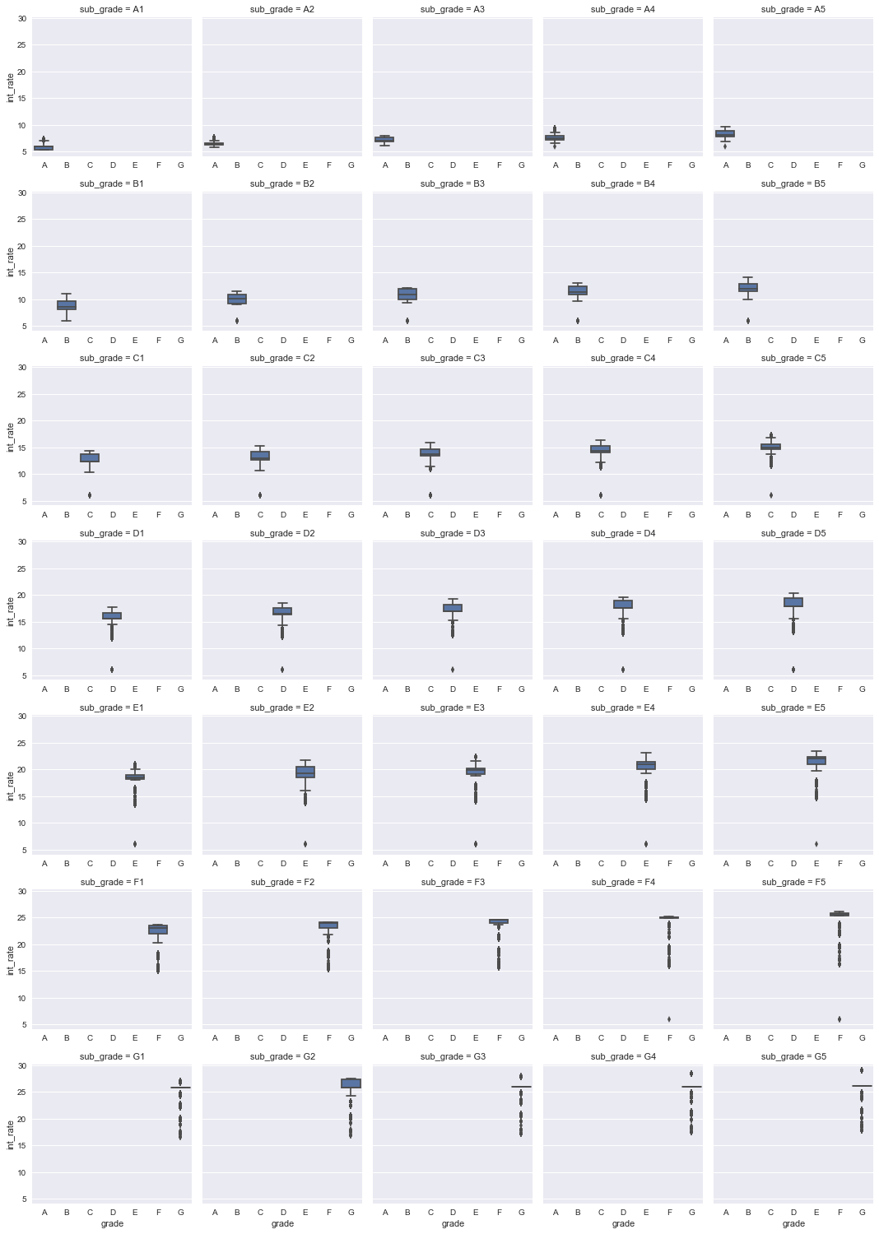
Data Explanatory Analysis
Analyzing interest rate distribution for each grade, factored over sub grade.
Figure 1: Analysis of interest rate for Grade A
Figure 2: Analysis of interest rate for Grade G
Notes:
This the box plot for rate distribution for each grade.
We can see that the interest rates are higher for lower grade.

Slide 10
Data Preparation & Processing
Removed the columns which had more than 50% of missing data. Also removed the columns that has no direct relation to our analysis such as ID’s and other unique identifiers.
Removed the variables which has only one category such as policy_code , pymnt_plan and initial_list_status, application_type.
Three types of categorical features: ordinal, nominal and binary. We encode these with built-in Spark APIs using StringIndex API for ordinal feature, VectorAssembler API for nominal feature and perform custom binary encoding for binary feature.
For our classification model we needed to add a class label variable “isDefault” to our data set. isDefault =1 if the loan is defaulted and 0 if not defaulted.
We labeled our data based on the features provided in data. “Default", "Charged Off", "Late (31-120 days)", "Late (16-30 days)", "Does not meet the credit policy. Status:Charged Off“ were
considered as defaulted loans.
Notes:
Though the data was good quality, we found out that we have to perform some cleanup activity.
First we removed the records which have more than 50% of missing values.
Then for better interpretation of results we convert some continuous variables into ranges.
We use StringIndexerAPI to convert the ordinal features such as borrowers experience level and VectorAssemblerAPI to convert the rest nominal features. Following which, we binary encoded the variables with binary values.
For our classification model we

Slide 11
Machine Learning Classifiers
We developed five classifier models to determine and compared their predictive capabilities. We utilized multiple assessment metrices (given below) to determine the most
successful model. Such as,
Confusion Matrix
Sensitivity VS Specificity
ROC curve
Maximum Likelihood
Hyper Parameter Learning

Slide 12
Logistic Regression
Logistic regression is a popular method to predict a categorical/binary response.
The main intention behind using this learning algorithm is to handle
the class imbalance. Logistic regression is one of the implementation
of linear models, for which spark provides ability to handle the class
imbalance by adding a class weights.
We used pyspark.ml.classifier package to implement the model with
optimized hyper parameter. We also implemented “elasticnet”
regularization since it solves the limitations of both L1 and L2
regularization.

Slide 13
Naïve Bayes
To extend scope of our model building, we wanted to include a generative machine learning model (probabilistic classifier) in our trails.
The intention behind using this classifier was to handle the class
imbalance issue by adding the default prior belief (beta distribution
function) and calculate the max posterior probability.
We used pyspark.ml.classifier package to implement this algorithm
with only one optimized hyper parameter for Laplace smoothing.
Notes:
Note: - As we notice from the results, this algorithm is not performing well as compared to others. We tried to drill down the root cause for the issue, but the spark provides very abstract level API for the algorithm implementation and doesn’t provide much control on its implementation. As a side work, we try implementing this same model in R and Python, where we first calculated the Maximum Likelihood Estimator based on the distribution of each feature and used combinations of Alpha & Beta values (For beta distribution) for prior. We then calculated the max posterior probability to each observations and achieved 92.6% precision.

Slide 14
Random Forest
To further deal with the data imbalance issue, we tried random forest, ensembles of decision trees.
Random forest is the aggregation of multiple decision trees which
usages entropy/Gini to find the impurities, which makes it less
sensitive to the class imbalance.
The spark implementation supports random forest for binary as well
as multiclass classifications.
We used pyspark.ml.classifier package to implement this algorithm
with optimized hyper parameter. We also tested our model with
different bin sizes and tree debts.

Slide 15
Gradient Boosting Classifier
In contrary to random forest, which tried to minimize the error by reducing the variance, we tested the opposite way by reducing the bias.
Boosting reduces error mainly by reducing bias and also to some extent
variance, by aggregating the output from many models.
GBM is a boosting method, which builds on weak classifiers. The idea is
to add a classifier at a time, so that the next classifier is trained to
improve the already trained ensemble in sequential order.
We used pyspark.ml.classifier package to implement this algorithm with
optimized hyper parameter. We also tested our model with different step
sizes for gradient descent and tree depth.

Slide 16
SVM
Finally we attempted Linear Support Vector Machines which also support class imbalance.
This implementation of linear model in Spark MLLib framework
provides ability to handle the class imbalance by adding weights to
our prediction class.
We used pyspark.ml.classifier package to implement this algorithm
with optimized hyper parameter for penalty term for L-2 regularization (C)
and gamma values.

Slide 17
Model Tuning and ML Pipeline
Parameter Grid to select the hyper params
ML Pipeline to create stages for feature vectorization and estimators
Cross Validator
Classification Evaluator
Best Hyper parameters for individual classifier algorithm

Slide 18
Summary of Results
 | Accuracy(%) | Precision (%) | Recall (%) | F1 Score (%)
Naïve Bayes | 50 | 49.96 | 94.31 | 65.32
Logistic Regression | 95 | 96.05 | 99.0 | 97.50
Random Forest | 99 | 100.0 | 99.9 | 99.99
Gradient Boosting Classifier | 100 | 100.0 | 100.0 | 100.00

Slide 19
Model Usefulness
Our model can be useful to provide comprehensive analysis of the
historical data as well as a smart prediction about the investor’s
money to lower their risk.
By developing a nearly perfect prediction model, we would hope to
reduce the number of delinquencies in the investment and helps
genuine borrowers to maintain their credit ratings. This would help
lending club to engage more investors and borrowers in their
platform, hence increasing the revenue growth

Slide 20
Future Work
We currently tried to handle class imbalance issue by providing class
weights, because as of this moment, apache spark’s existing MLlib
framework only allows this technique with only few algorithms.
In future, we would hope to modify the goal of our modelling and try to
predict the customer’s credit rating (grade/sub grade) based on their credit
loan history. This would extend our learnings to solve a multi-class
problem.
Notes:
SMOTE - Synthetic Minority Over-sampling Technique

